Slide 1



The implementation VR to transform training at TVETs

Slide 2

Project Background
TVET institutions crucial for skilled workforce.
COVID-19 challenges traditional face-to-face learning.
VR tech explored for immersive, cost-effective welding training.
Study based on CHIETA Blended Learning Program and focus group insights.
Proposal: VR welding facility to enhance skills and safety.

Slide 3

Project Framework
Blended Learning: Integration of online and traditional teaching methods, enhancing learning experiences.
Pedagogical Agents: Modules facilitating learning, providing guidance, and motivation.
Engaging Technologies in Education: VR/AR/MR systems offer immersive learning experiences.
Benefits:
Immersive experience and real-time feedback
Practical skills development
Safety
Customization
Cost-effectiveness
Accessibility
Collaboration

Slide 4

Development of learning content
Aligning with NQF Level 04 and QCTO Standards, the study refined and expanded the original welding training content from CHIETA to align with industry standards and educational best practices.
Developed 8 knowledge modules and 10 application modules covering essential skills for welding professionals, totaling 96 credits.
Objective, enhance training effectiveness and provide a more enriched learning experience in welding.

Slide 5
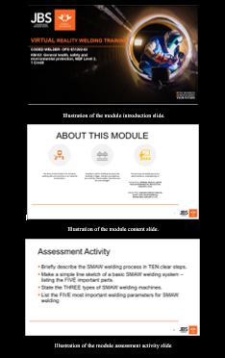
Knowledge modules development
For each Module PowerPoint slides developed for each module, offering fundamental learning content from the CHIETA guide.
Slides include text, images, diagrams, and videos, ensuring a visually appealing and comprehensive presentation.
There are assessments activities for each topic to evaluate comprehension and knowledge retention, including long and short questions.
Learning outcome involves producing weld samples meeting acceptance criteria specified by welding codes.
Learners tasked with applying welding principles, handling tools and equipment properly, and producing welds in various positions and materials.

Slide 6
Application Modules development
The VR welding facility aims to improve skill acquisition, safety protocols, and address logistical challenges in traditional training methods.
Leveraging interactive VR platforms, the facility adopted CHIETA teaching materials, promoting practical skill development through an interactive learning experience.
Systems utilized include Unity Game Engine, Blender, Steam and Steam VR, Streaming Assistant, and Pico Nico VR Headset.
Designed to offer instant feedback on welding performance, allowing students to make adjustments and improvements quickly, promoting mastery of techniques over time.
The creation of an environment cantered around three fundamental welding elements:
Observation and safety guidelines
Training and engagement
Testing (after doing practical sessions)

Slide 7
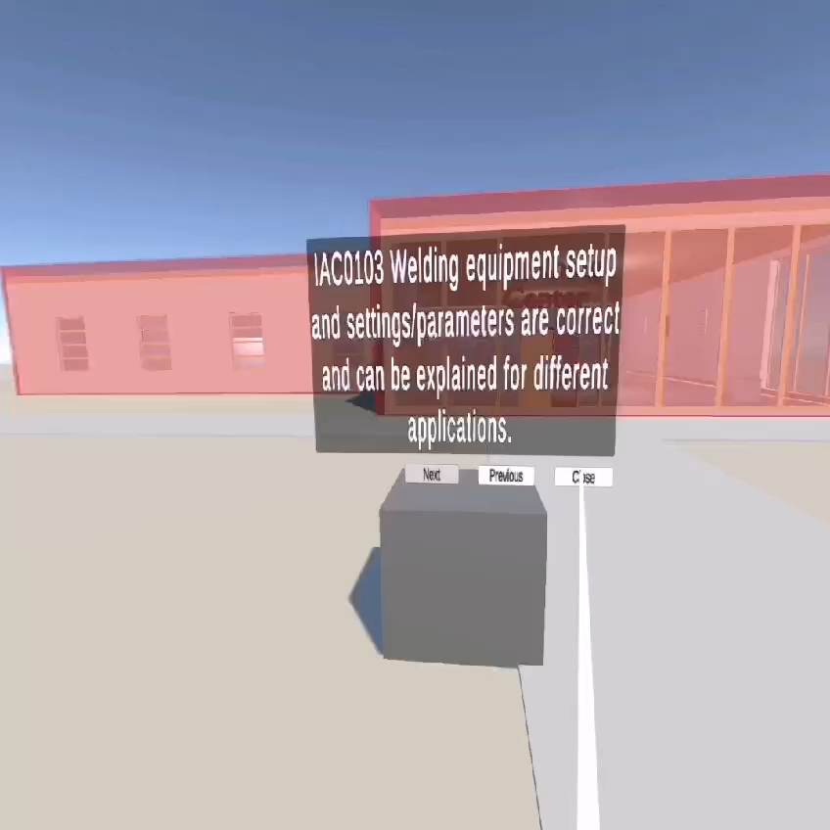
Illustration of the project outcomes

Slide 8

Conclusion
Industry commitment to continuous improvement signals readiness for transformative advancements.
Project showcases forward-thinking in welding education, prioritizing innovation and adaptability.
Future projects: VR classrooms transformation education and exploring diverse TVET training qualifications.

Slide 9
The End

